Slide 1
Lecture 11: Array and Vector
Dr. Tsung-Wei Huang
Department of Electrical and Computer Engineering
University of Utah, Salt Lake City, UT
Notes:
Morning everyone
Today we are looking into control flow in C++.

Slide 2
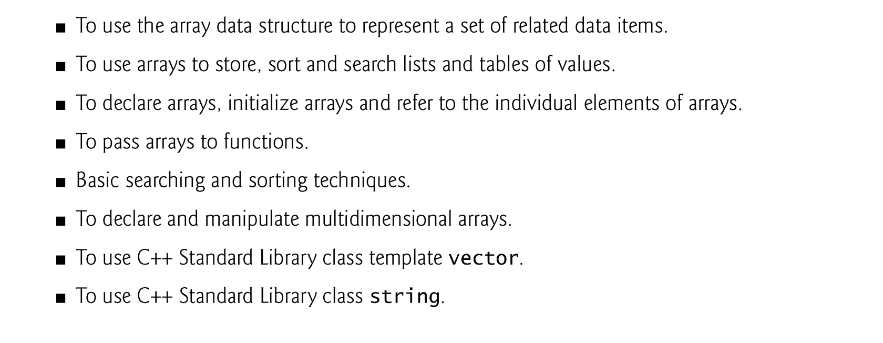
Learning Objective

Slide 3
Array
An array is a consecutive group of memory locations that all have the same type.
To refer to a particular location or element in the array, specify the name of the array and the position number of that element.
The position number is formally called a subscript or index.
This number specifies the number of elements from the beginning of the array.
A subscript must be an integer or integer expression (using any integral type).
The first element in every array has subscript 0 (zero) and is sometimes called the zeroth element.

Slide 4
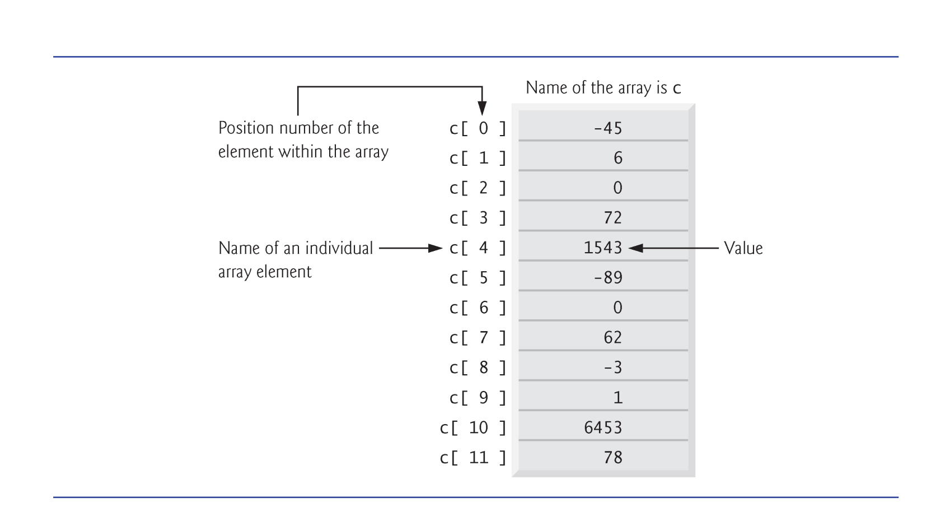
Memory Layout of Array

Slide 5
Declaring an Array
Arrays occupy space in memory.
To specify the type of the elements and the number of elements required by an array use a declaration of the form:
type arrayName[ arraySize ];
Ex: int n[5]; → 5 integer elements
The compiler reserves the appropriate amount of memory.
All elements are put in a continuous memory space.

Slide 6
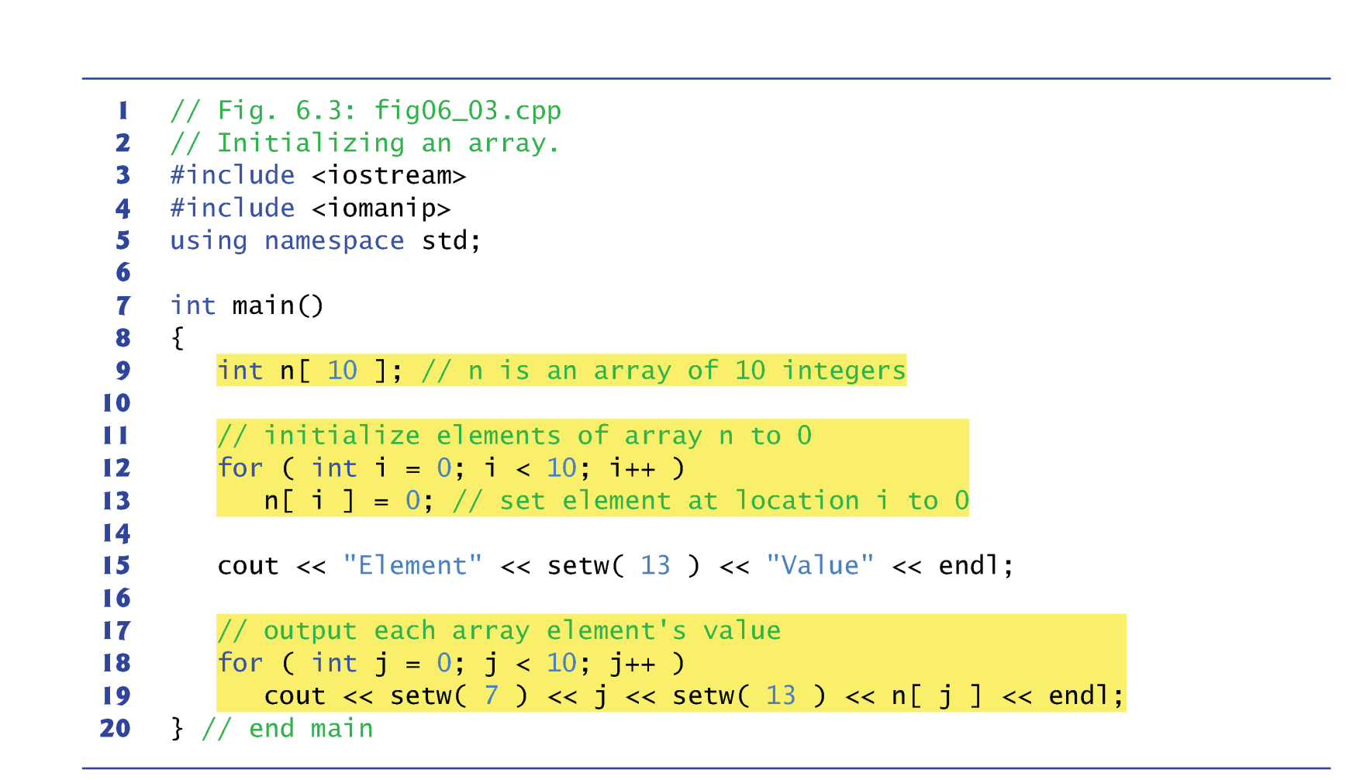
Array Example

Slide 7
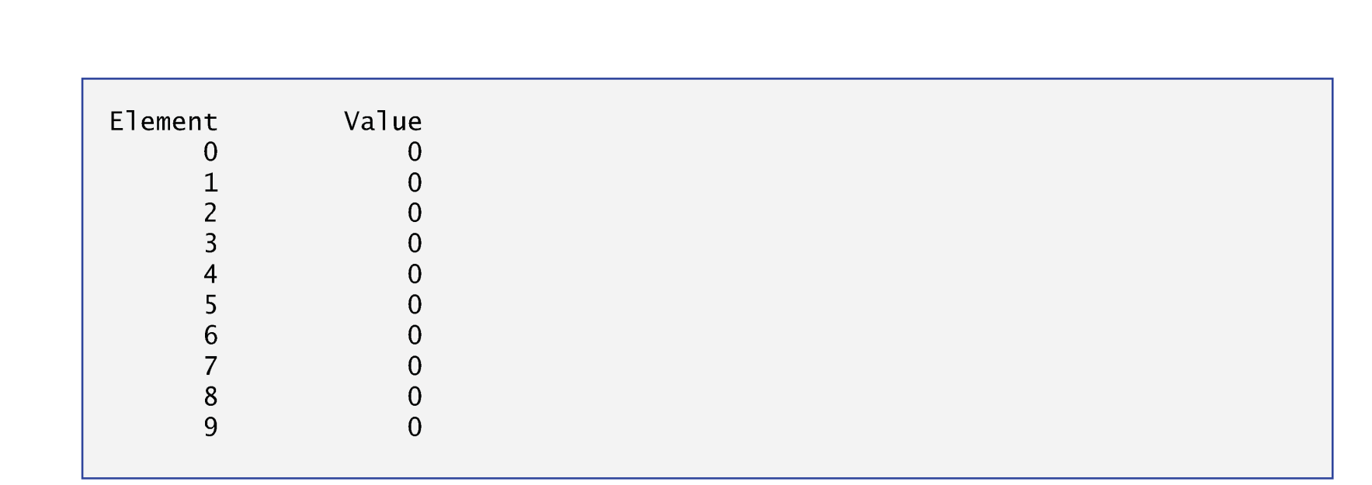
Array Example

Slide 8
Initializing an Array
The elements of an array also can be initialized by a brace-delimited comma-separated list of initializers.
The previous program uses an initializer list to initialize an integer array with 10 values (line 10).
If there are fewer initializers than elements in the array, the remaining array elements are initialized to zero.
If the array size is omitted from a declaration with an initializer list, the compiler determines the array size automatically
By counting the number of elements in the initializer list.
Ex: int n[] = {1,2,3,4,5}; → 5 elements

Slide 9
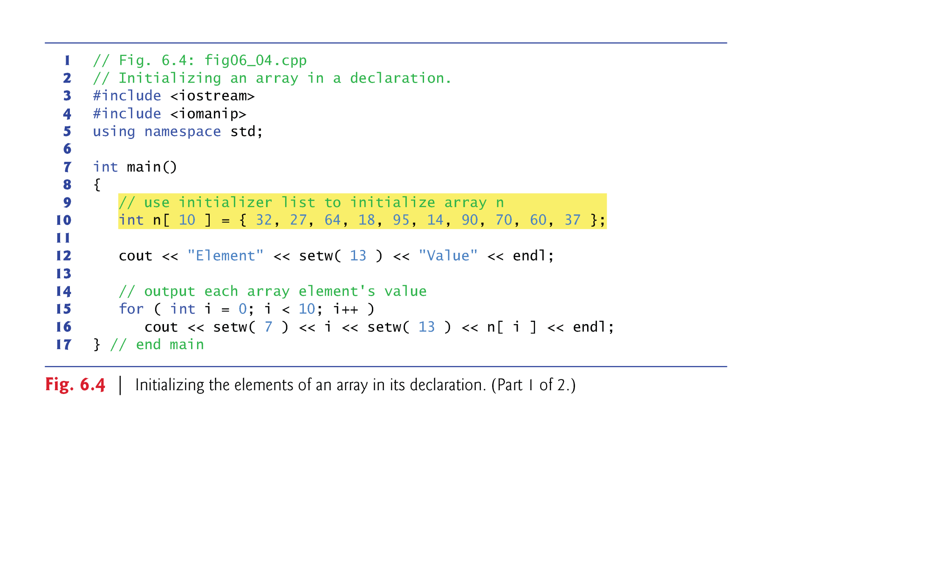
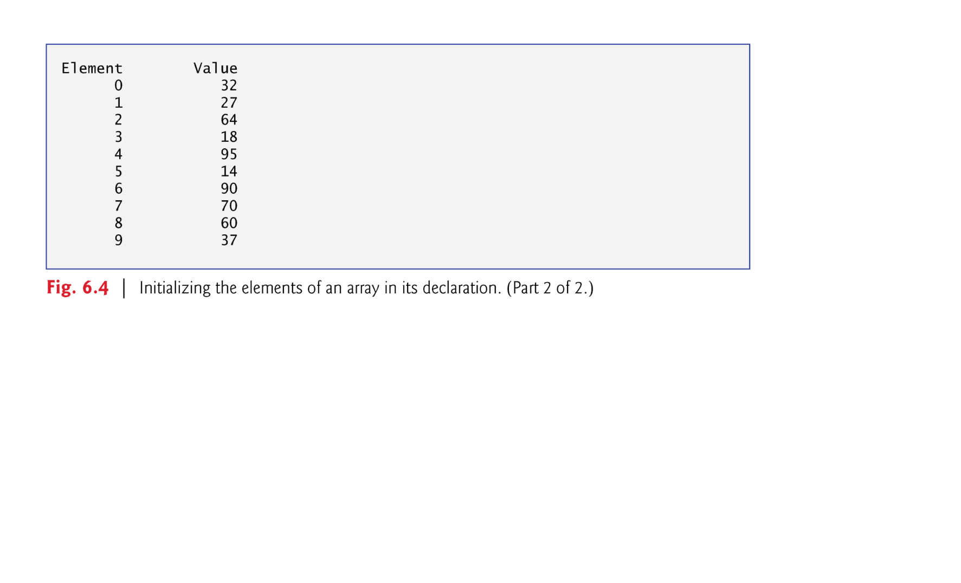
Example: Initializing an Array

Slide 10
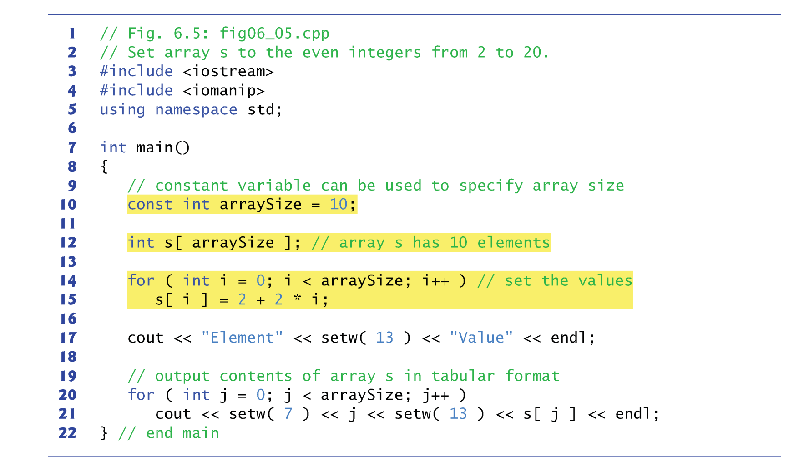
Specify the Array Size

Slide 11
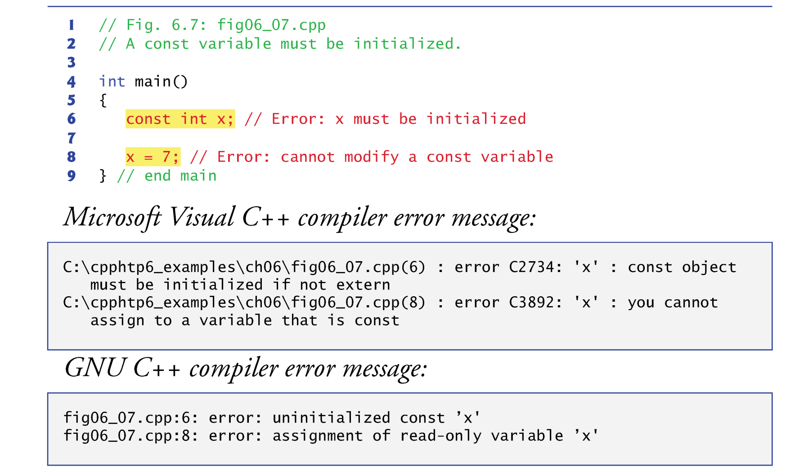
const Qualifier

Slide 12
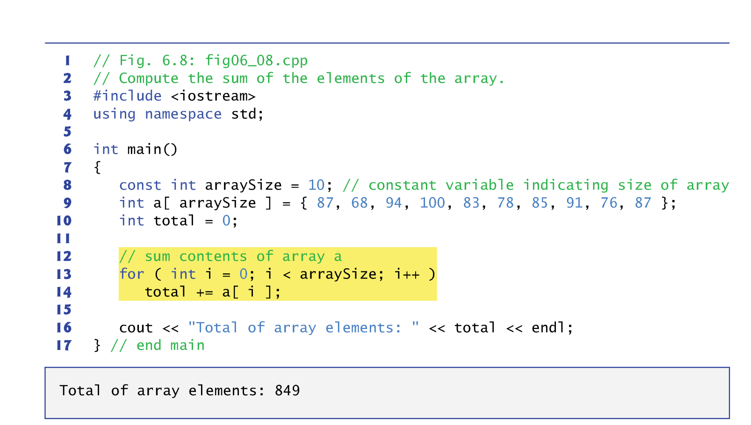
Practice 1: Summing Elements in an Array

Slide 13
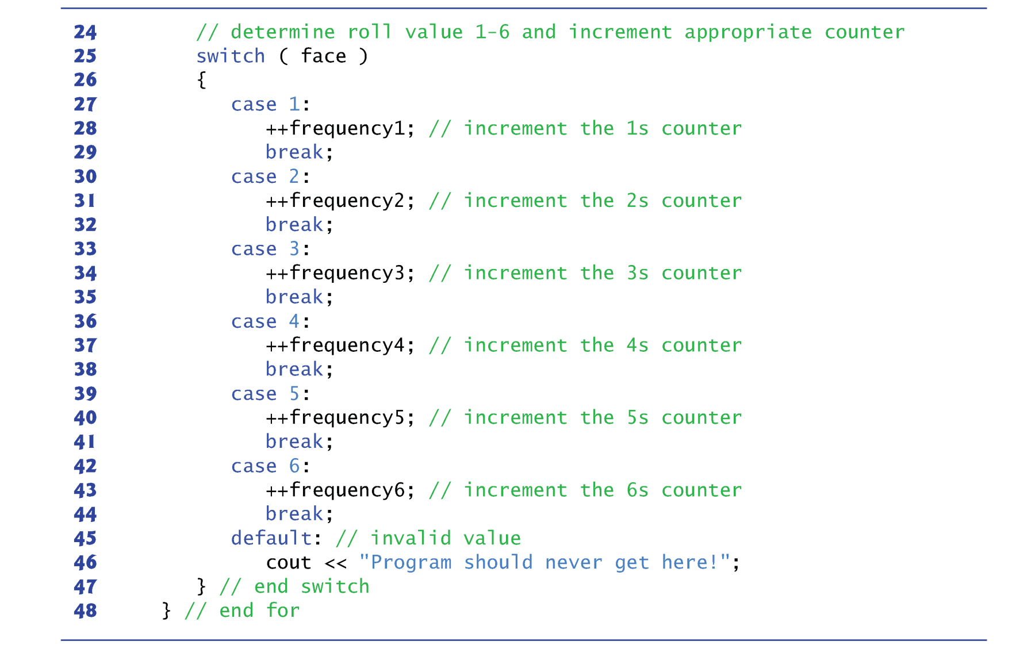
Practice 2: Array as Counter
Sometimes, programs use counter variables to summarize data, such as the results of a survey.
In previous die-rolling program, we used separate counters to track the number of occurrences of each side of a die.

Slide 14
C++ STL Vector
C-style pointer-based arrays have great potential for errors and are not flexible
A program can easily “walk off” either end of an array, because C++ does not check whether subscripts fall outside the range of an array.
Two arrays cannot be meaningfully compared with equality operators or relational operators.
The size of the array must be passed as an additional argument when an array is passed to a general-purpose function.
One array cannot be assigned to another with the assignment operator(s).
C++ Standard class template vector represents a more robust type of array featuring many additional capabilities.
Defined in header <vector> and belongs to namespace std.

Slide 15
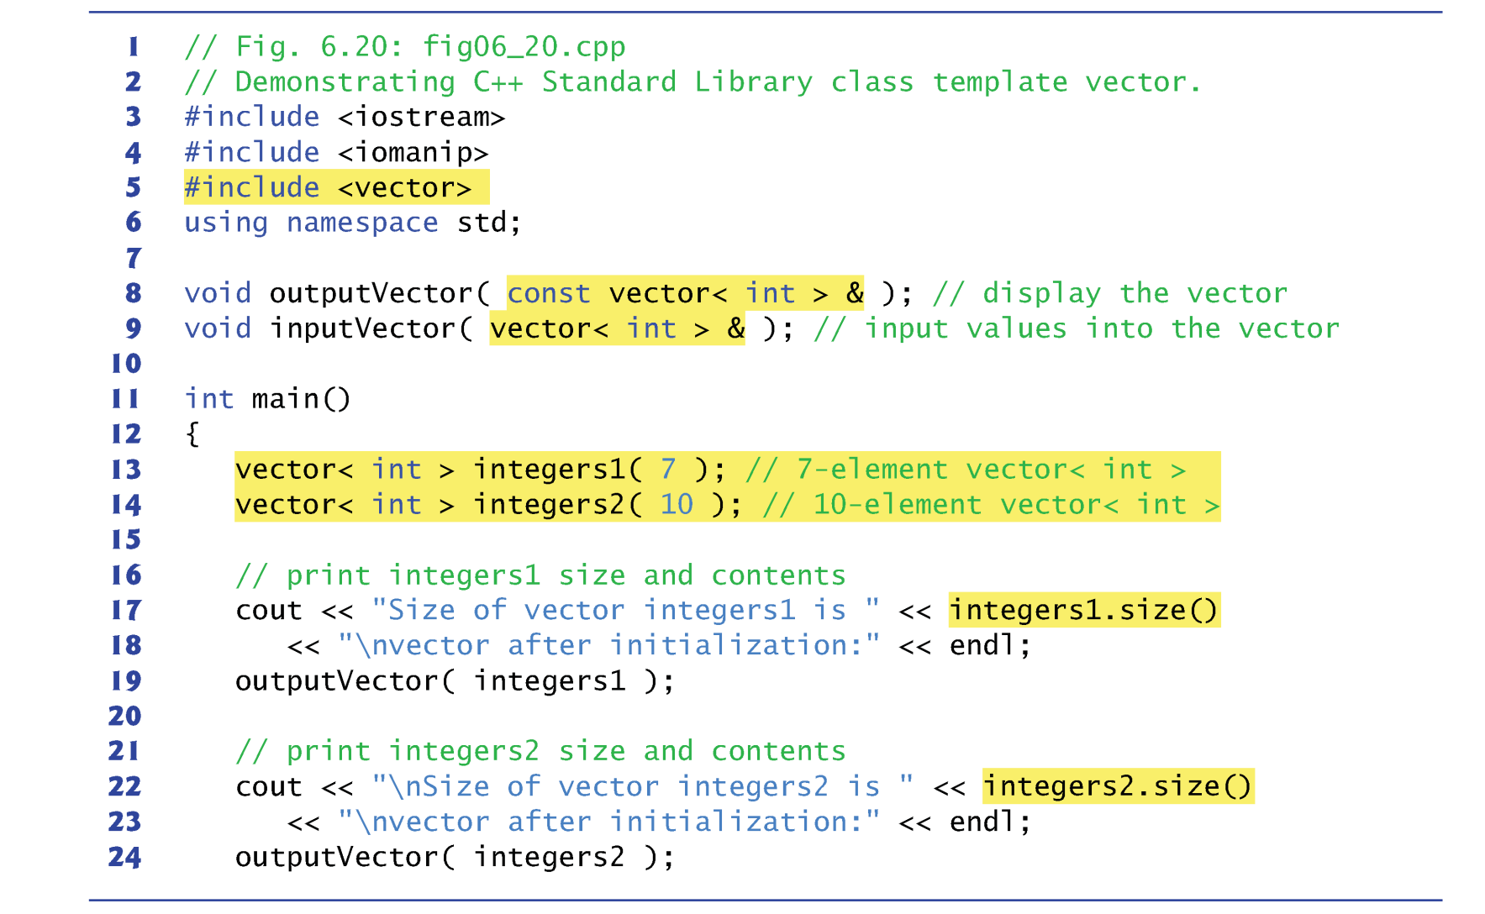
Vector Example

Slide 16
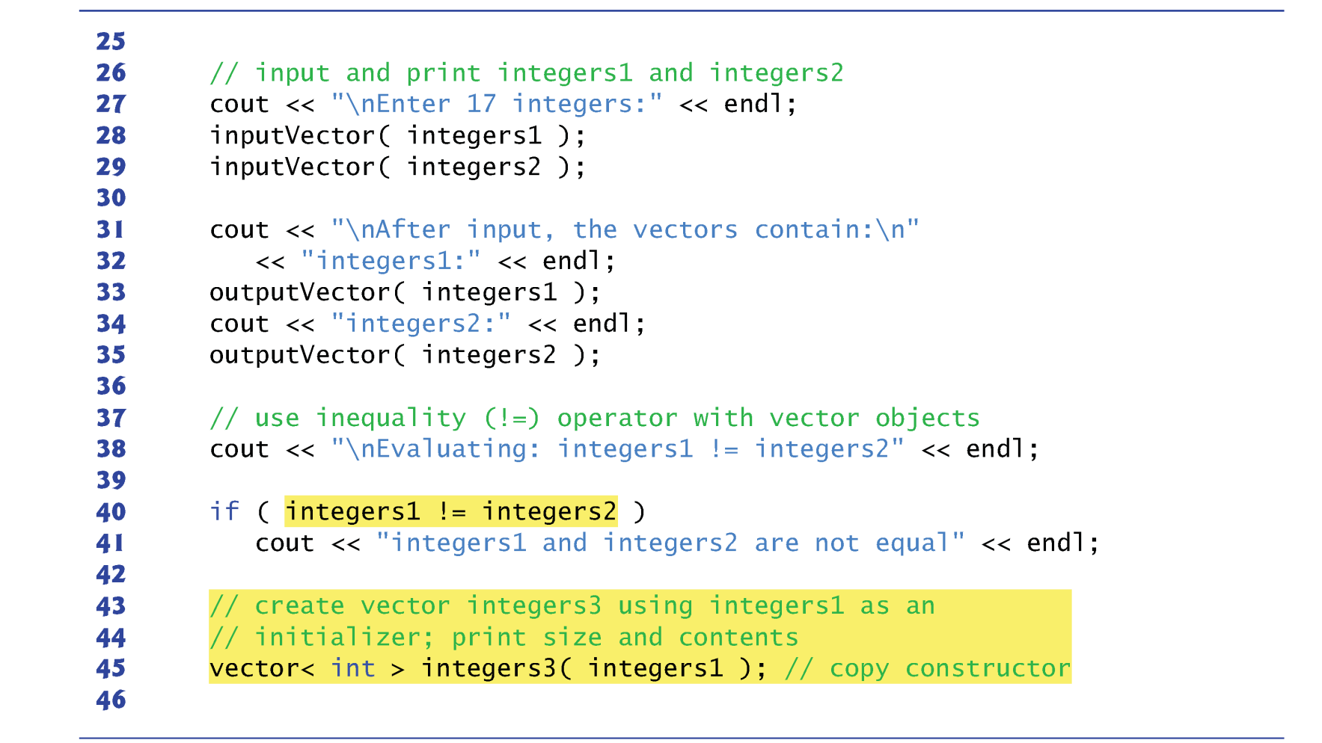
Vector Example

Slide 17
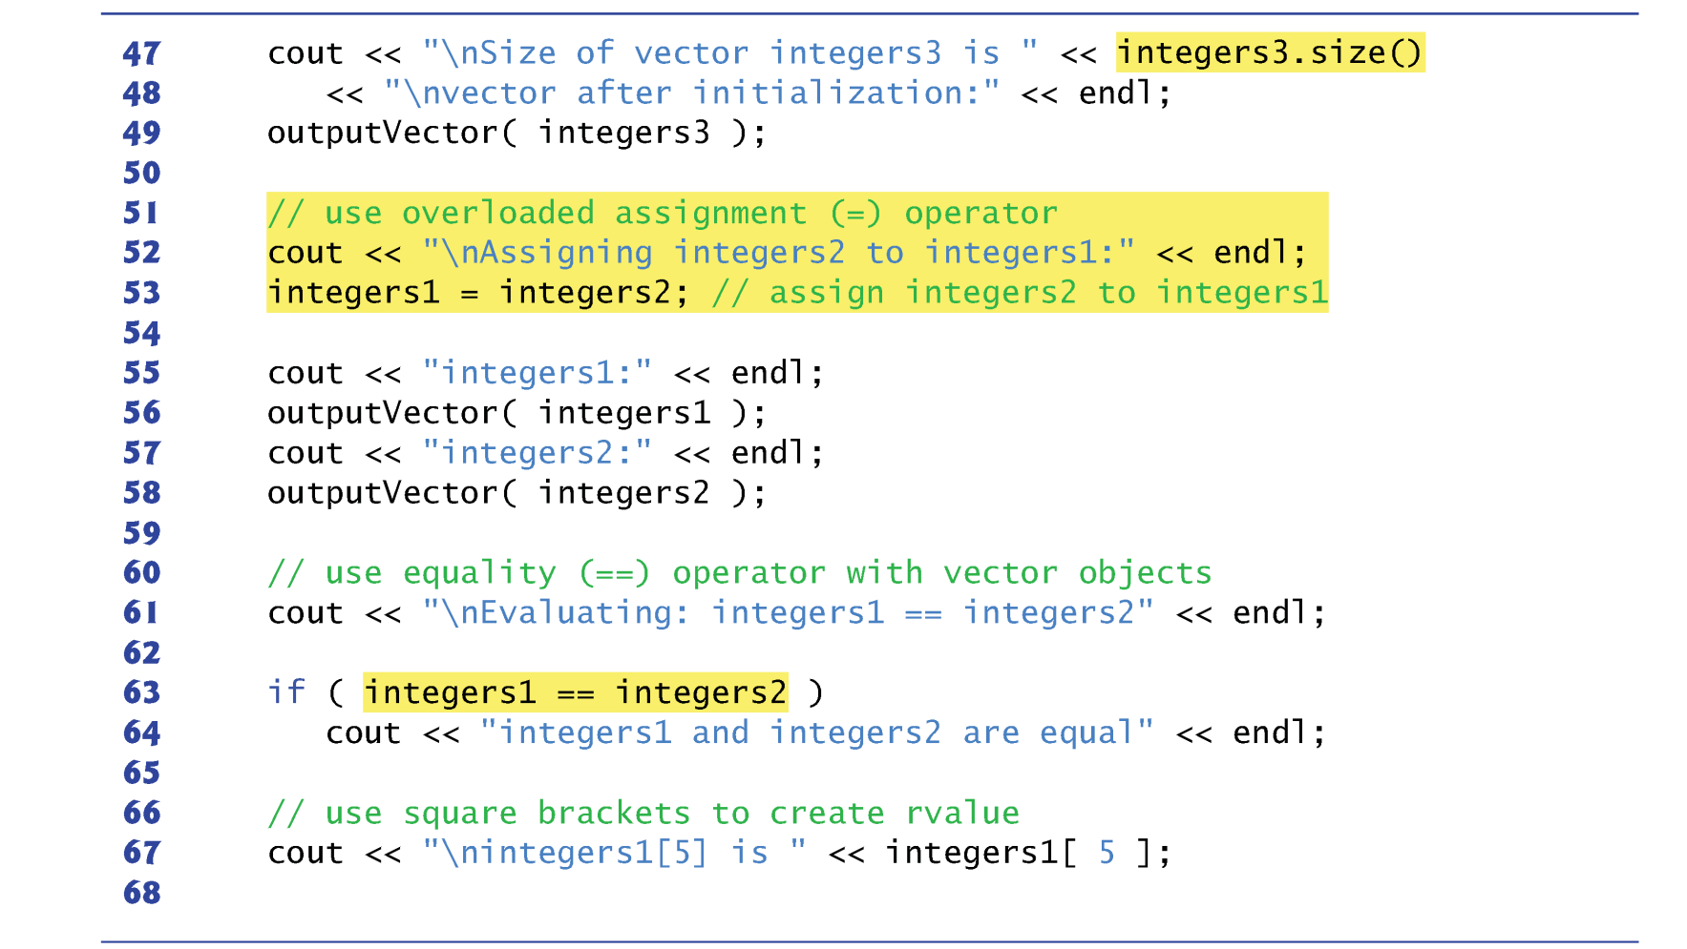
Vector Example

Slide 18
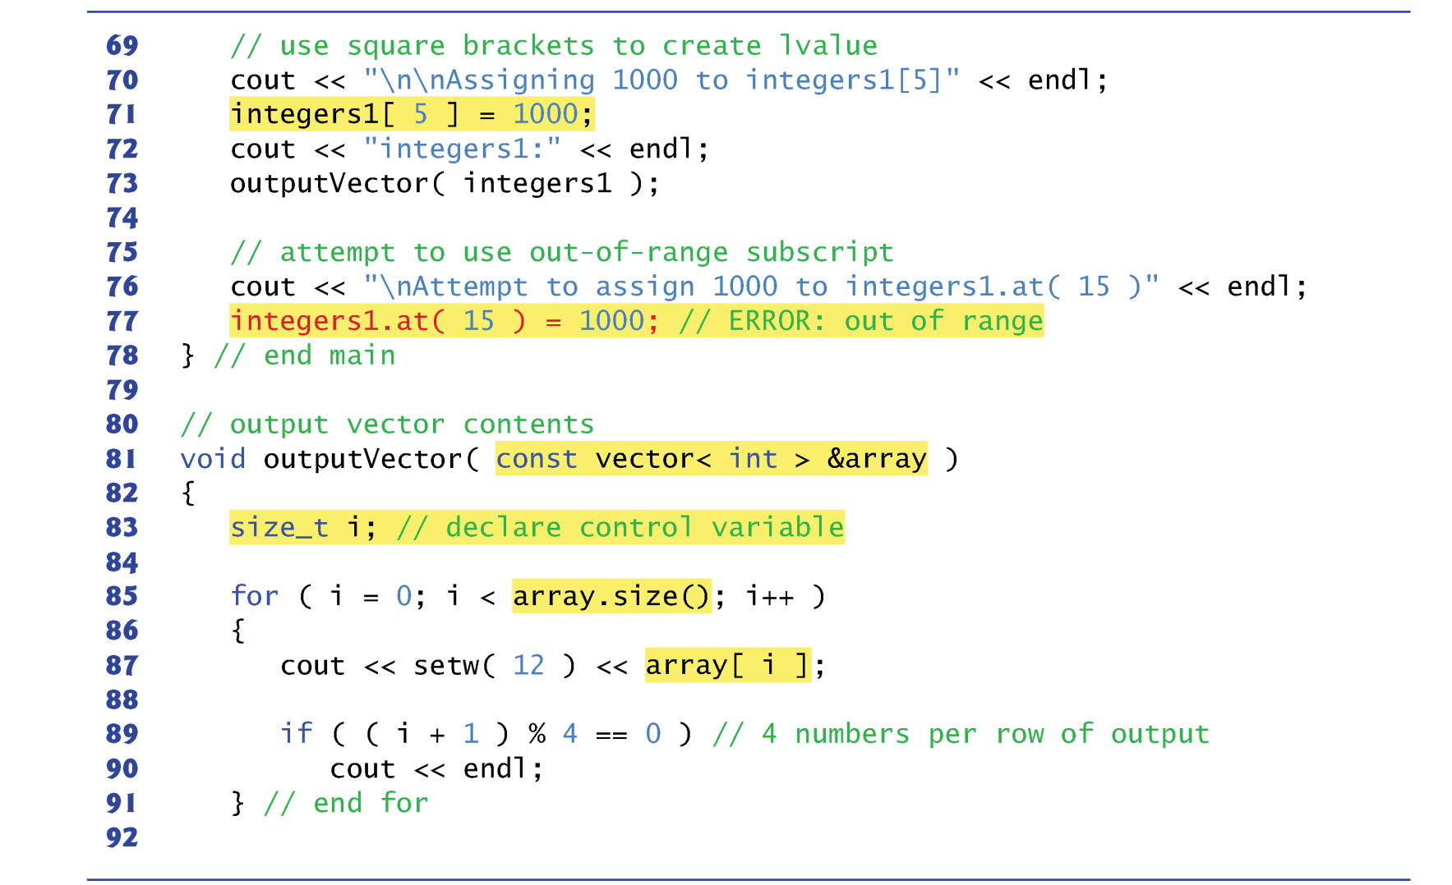
Vector Example

Slide 19
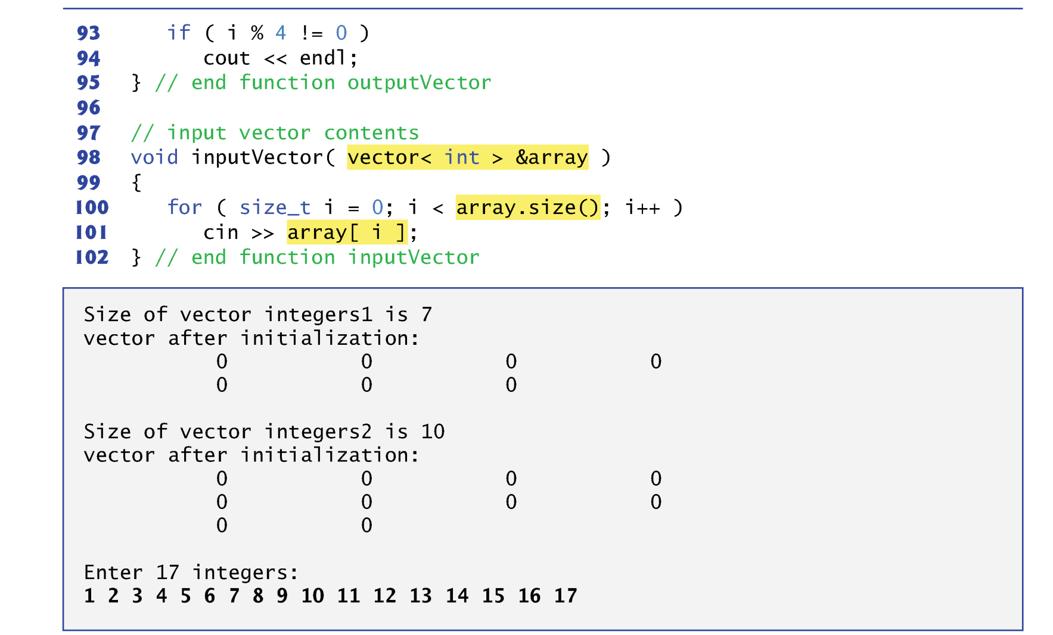
Vector Example

Slide 20
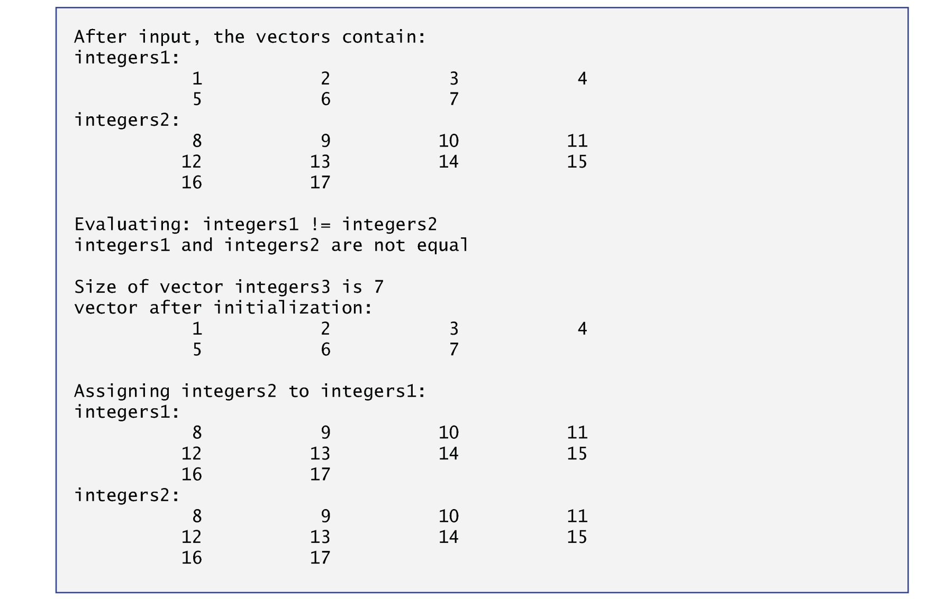
Vector Example

Slide 21
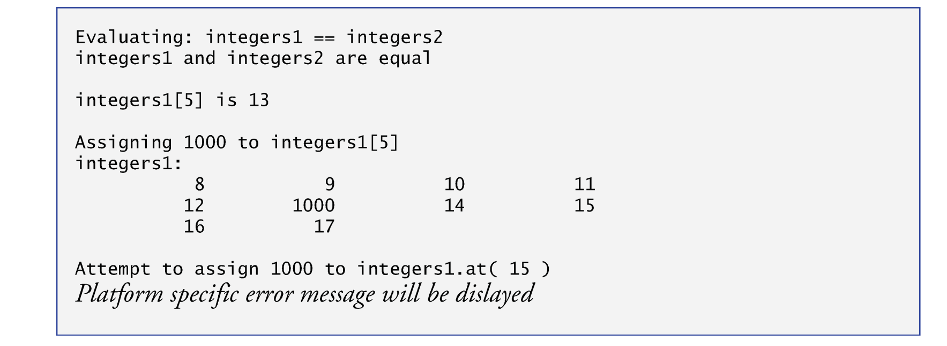
Vector Example

Slide 22
C++ STL Vector
By default, all the elements of a vector object are set to 0.
vectors can be defined to store any data type.
vector member function size obtain the number of elements in the vector.
You can use square brackets, [], to access the elements in a vector.
vector objects can be compared with one another using the equality operators.
You can create a new vector object that is initialized with a copy of an existing vector.

Slide 23
Search an Item in an Array
Often it may be necessary to determine whether an array contains a value that matches a certain key value.
Called searching.
The linear search compares each element of an array with a search key.
Because the array is not in any particular order, it’s just as likely that the value will be found in the first element as the last.
On average, therefore, the program must compare the search key with half the elements of the array.
To determine that a value is not in the array, the program must compare the search key to every element of the array.

Slide 24
Example 1
Input:
A std::vector vec of integer numbers
An integer number v
Output
“Yes”, if v can be found in vec
“No”, if v cannot be found in vec

Slide 25
Example 2: Maximum Subarray Sum Problem
Given a sequence of integer number, find the largest sum of contiguous array numbers
Notes:
The next example I am going to talk about is the maximum subarray sum problem. This is also another famous example of divide and conquer. Given a ...
That is, you are given a one dimensional array that may contain both positive and negative integers, find the sum of contiguous subarray of numbers which has the large sum. For example, if the array is -2, -3, ... etc, then the maximum subarray sum is 7.
Why is this problem important?

Slide 26
Practical Application
A basic routine of financial computing
Maximum subarray sum to find the optimal long-term investment
Notes:
Well, this is in fact a question I was asked by a financial company when I took an interview. If you look at stock market, the price over time changes a lot, right. It can go very low today, and become very high tomororw or next week, or even wihin the next couple hours.
If you look at a short-term investment, you always want to find a contiguous range that produces the maximum sum within a time period (of course, it has to be contigious because you buy the stock and then sell it, there is no other options)
So the problem is alwasy modelled as a sequence of numbers, positive and negative, potentially very large, and you want to quickly compute the largest subarray sum. And that gives you the best profit you may get in that certain period.

Slide 27
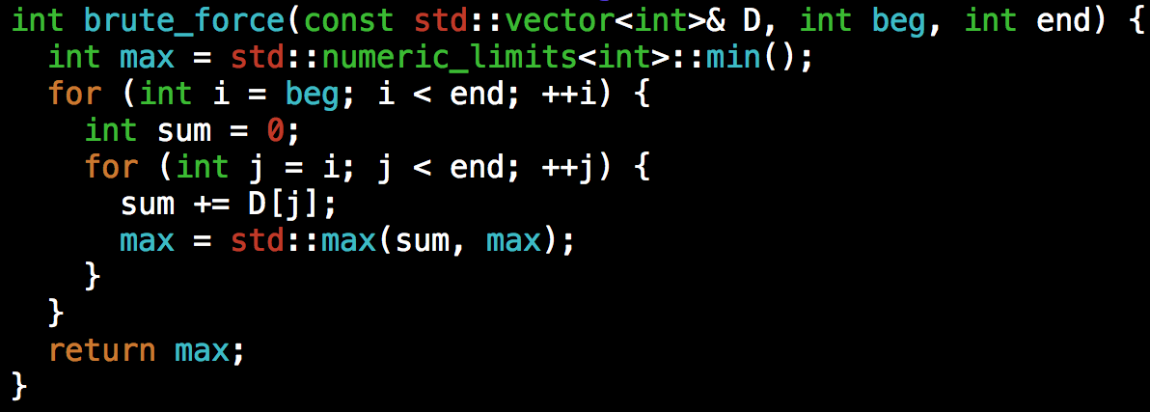
Debrief
The solution we presented has two-level loops
At worst, you need N² iterations, where N is the size of the input array
Can we do better?
Notes:
Now, let's go back to the problem itself.
Again, we always start with the simple approach, even though it is slow. At least you need to be able to find the solution first before you can improve it.
Any idea?
(click) The naive method is to run two loops. The outer loop picks the beginning element, the inner loop finds the maximum possible sum with first element picked by outer loop and compares this maximum with the overall maximum. Finally return the overall maximum. The time complexity of the Naive method is O(n^2).

Slide 28
LAB
Write a program that takes an input N from users and then ask the user to type in N integers (N>=10), storing in a std::vector<int>; then, your program should output:
The first three minimum numbers
The first three maximum numbers
Example: given {1, 4, 5, 9, 0, -1, 2, -100, -2}
First three minimum: -100, -2, -1
First three maximum: 9, 5, 4

